Slide 1
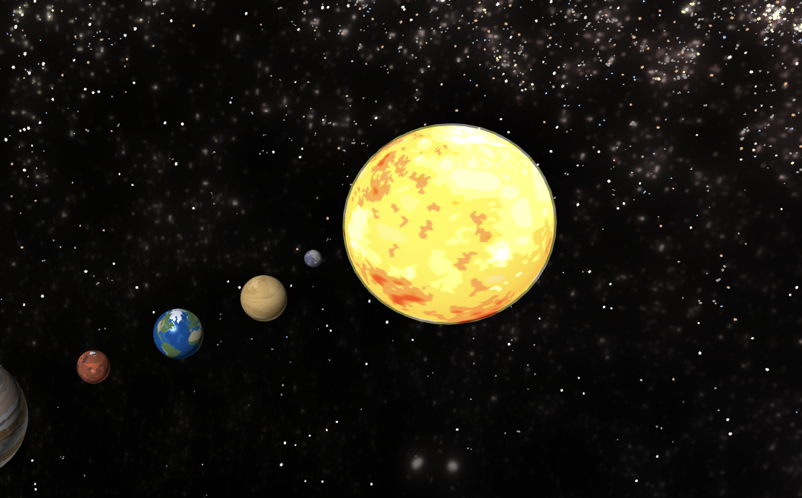
Lesson 1
Object Positioning and Scaling

Slide 2
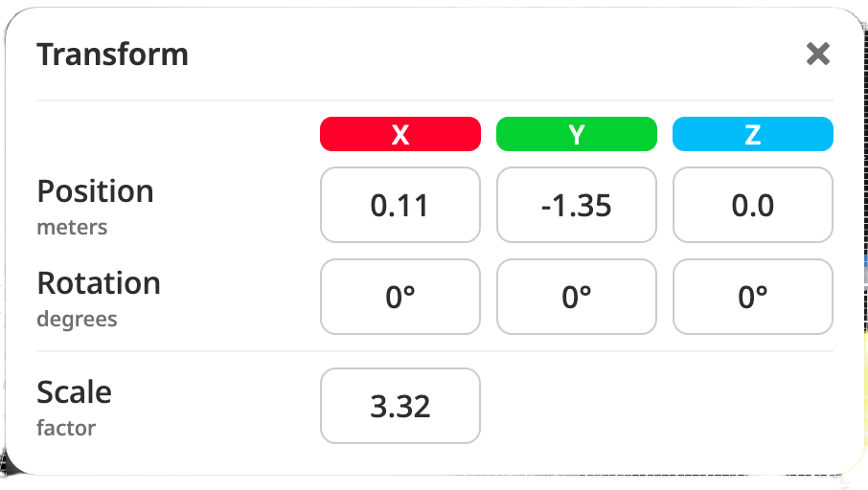
Lesson 1: Object Positioning and Scaling
Learning Objectives:
Position Objects in 3D space using X, Y, Z coordinates
Scale objects to realistic proportions
Understand transform controls

Slide 3
LESSON 1: OBJECT POSITIONING AND SCALING
Slide 3 of 7
Understanding 3D Space and Transform Controls
Coordinate System:
X coordinate: left(-) and right (+) positioning
Y coordinate: down (-) and up (+) positioning
Z coordinate: backward (-) and forward (+) positioning

Slide 4
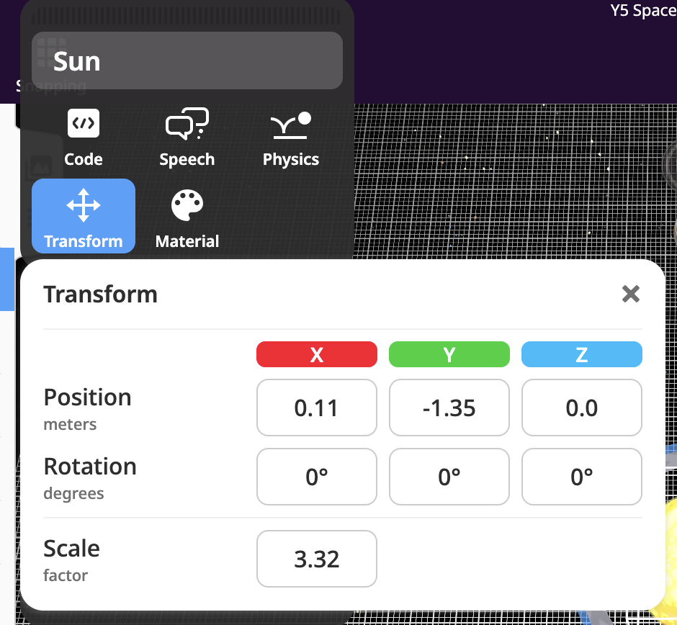
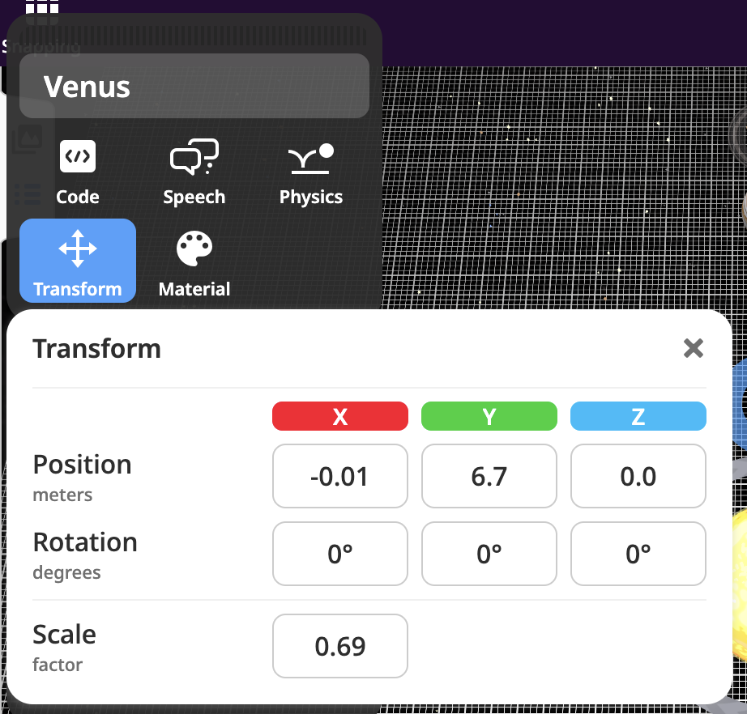
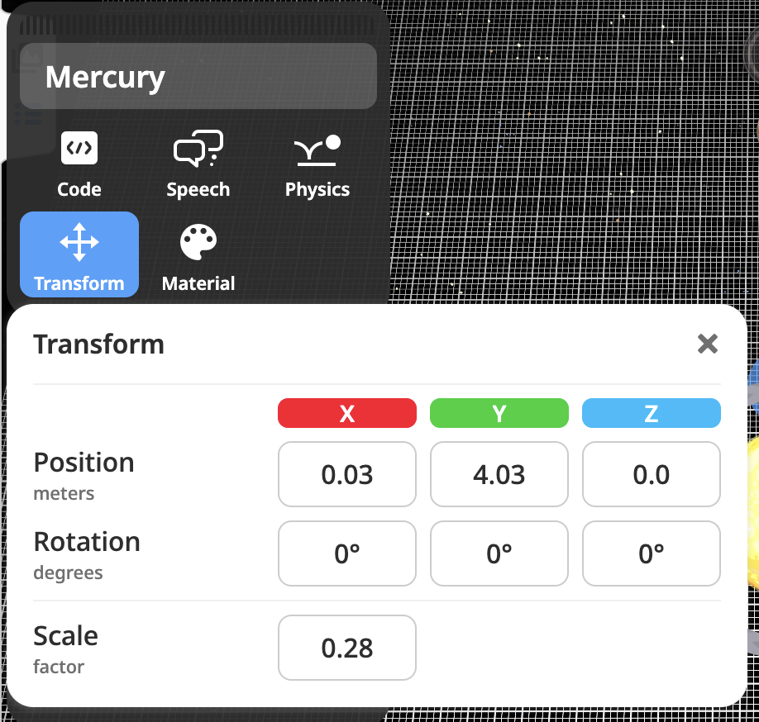
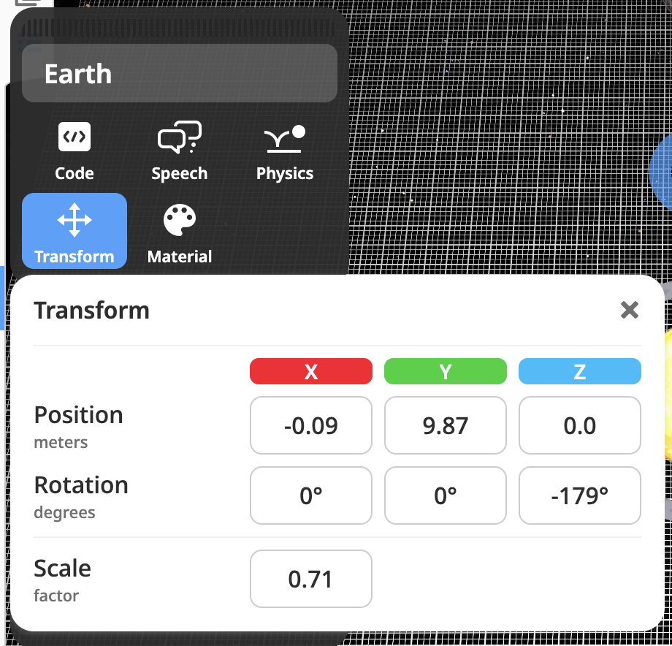
MILD CHALLENGE
LESSON 1: OBJECT POSITIONING AND SCALING

Slide 5
MILD CHALLENGE
LESSON 1: OBJECT POSITIONING AND SCALING

Slide 6
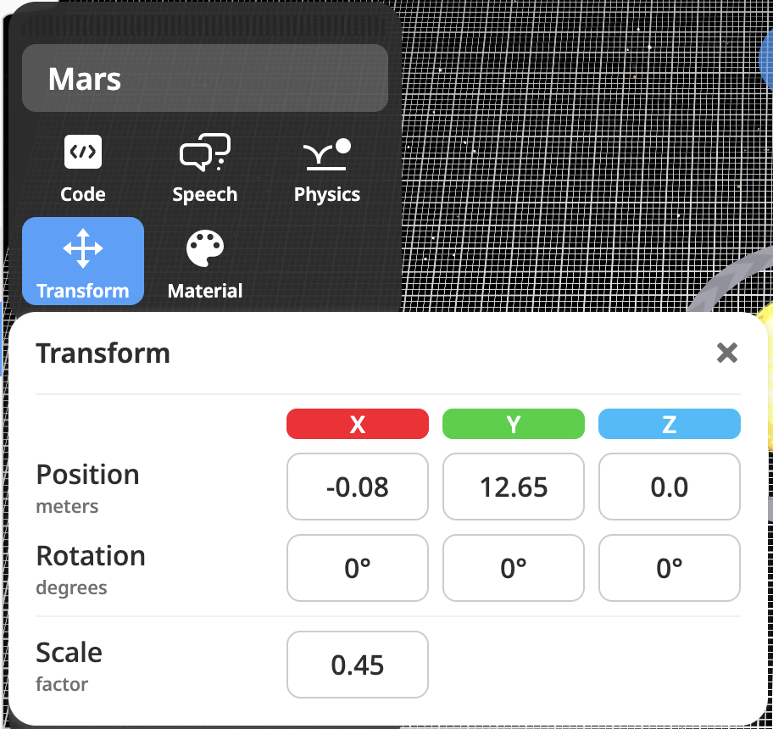
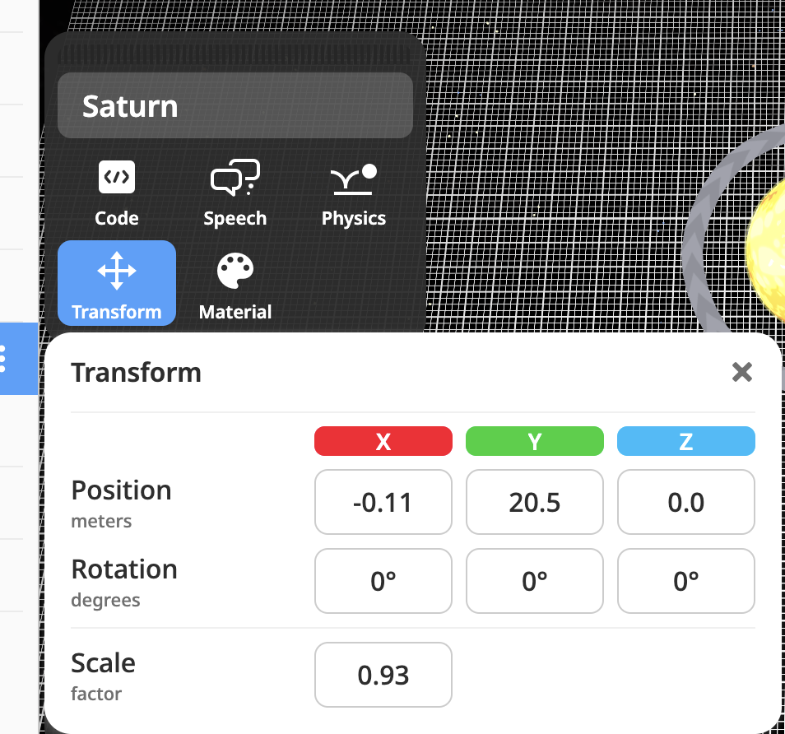
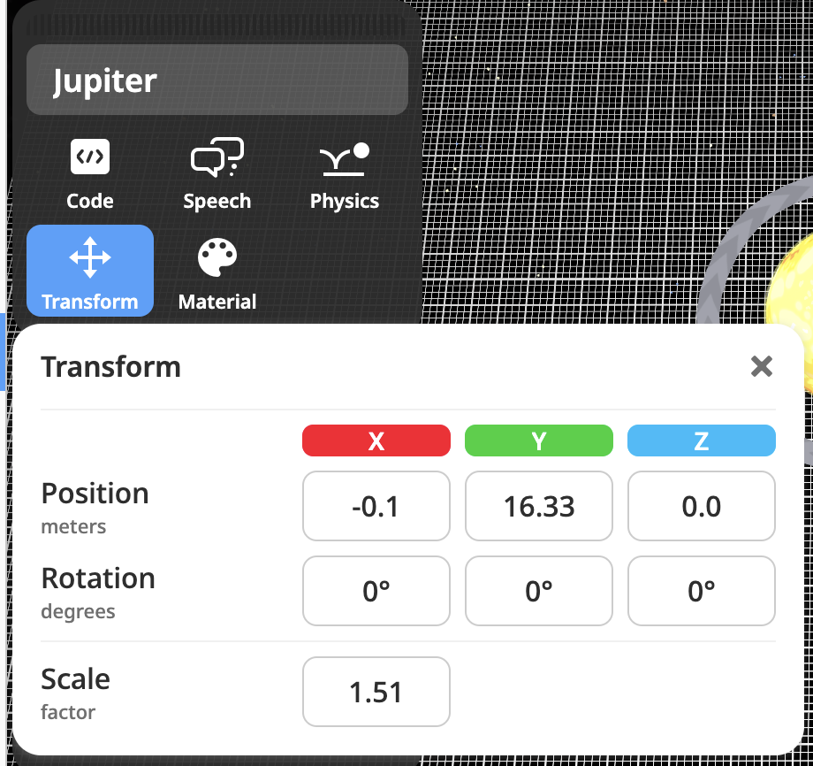
MEDIUM CHALLENGE
You did it when:
Your planets are in the right order and look realistic!

Slide 7
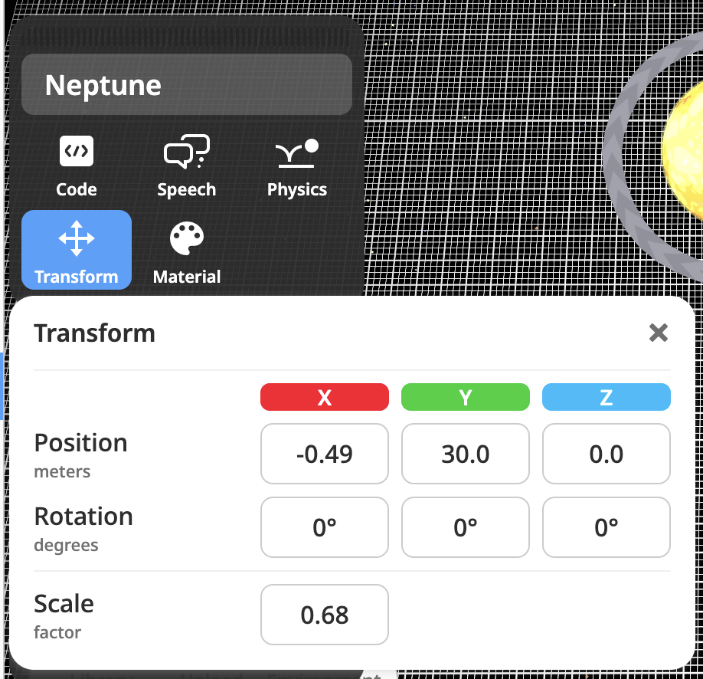
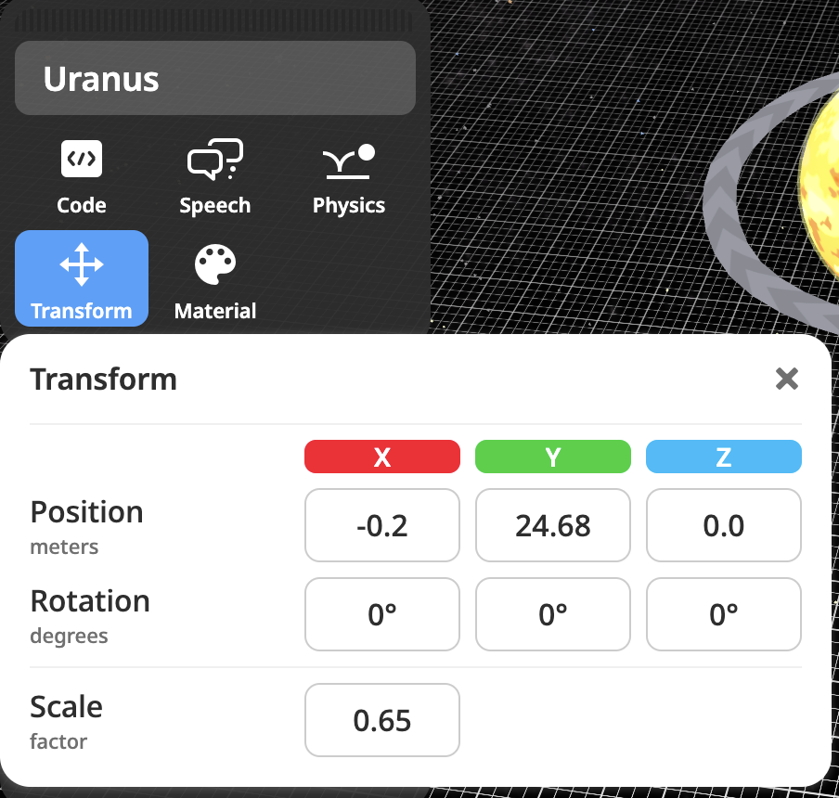
HOT CHALLENGE

Slide 9
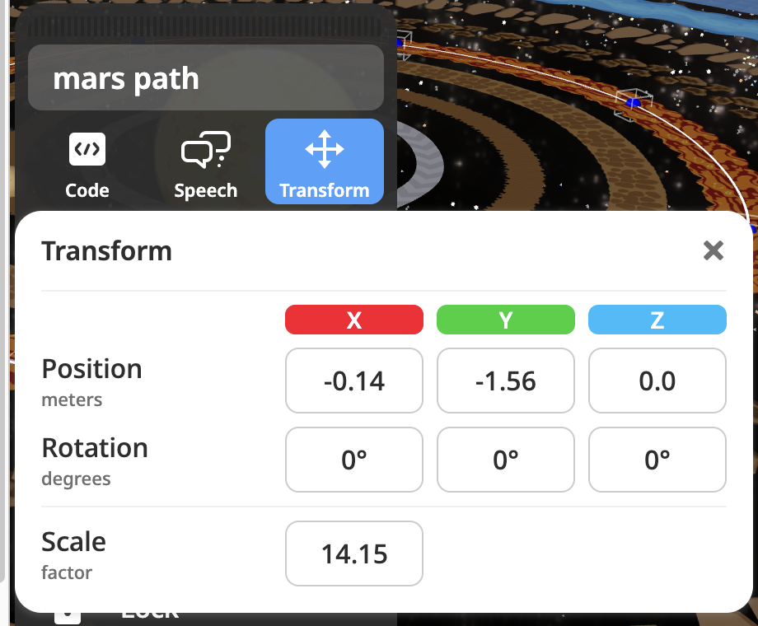
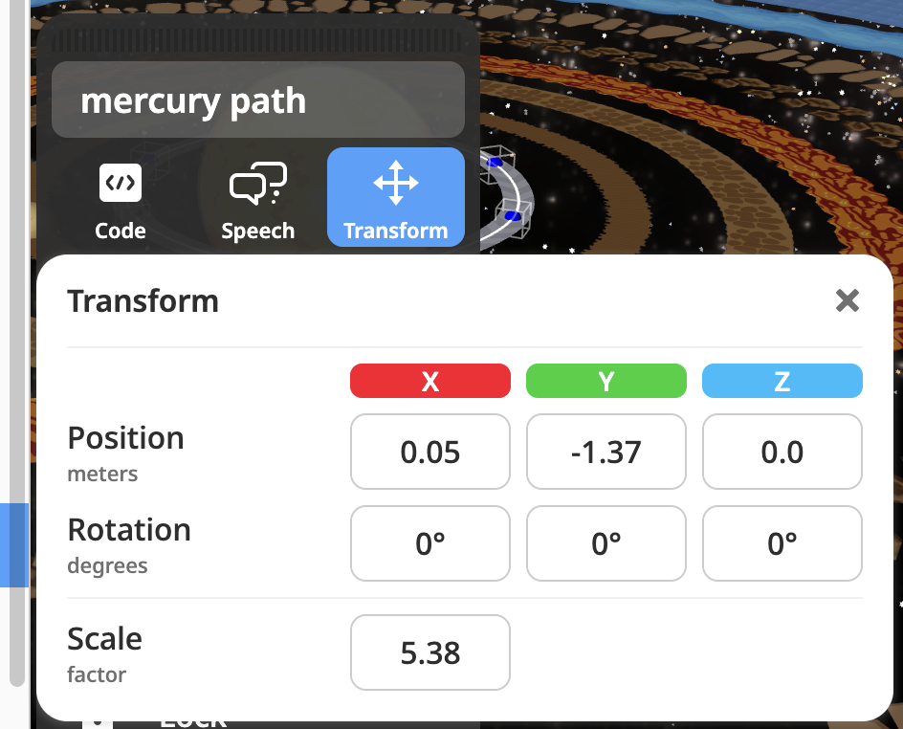
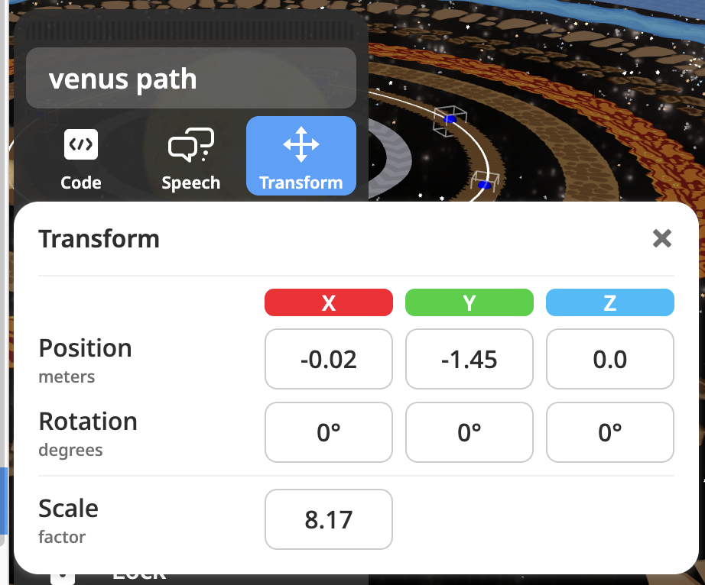
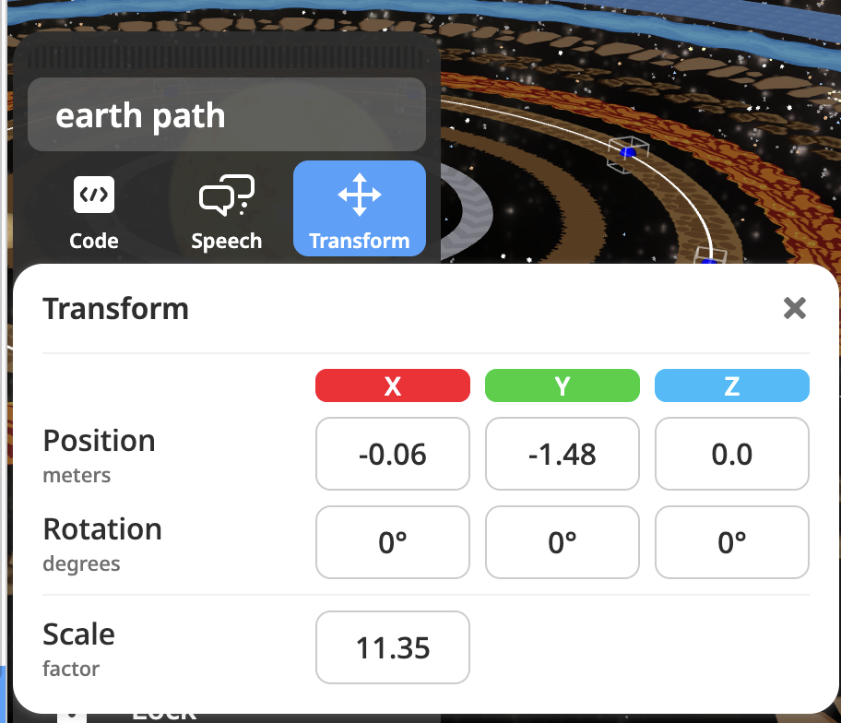
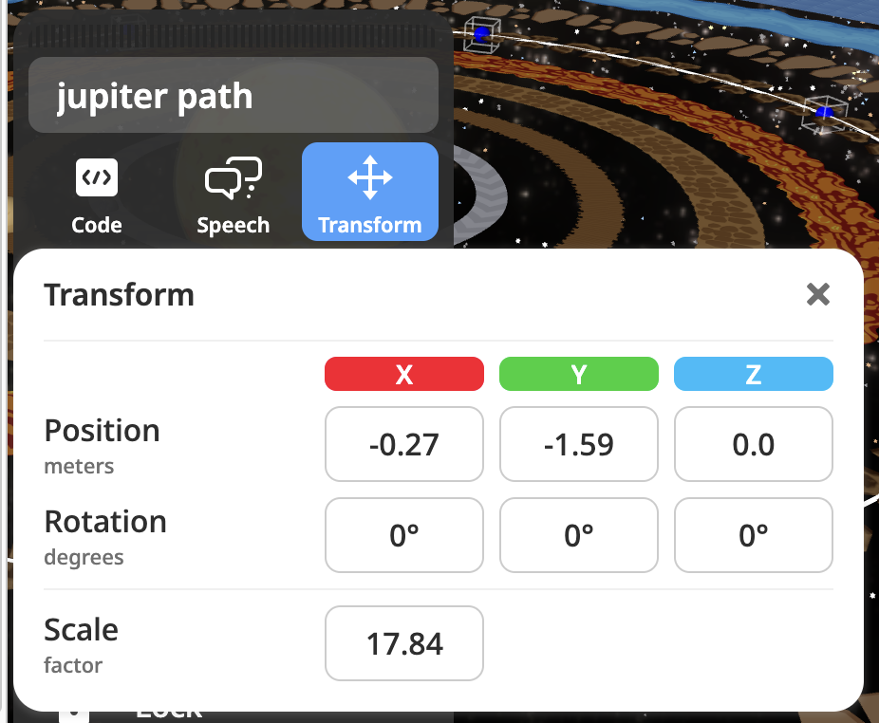
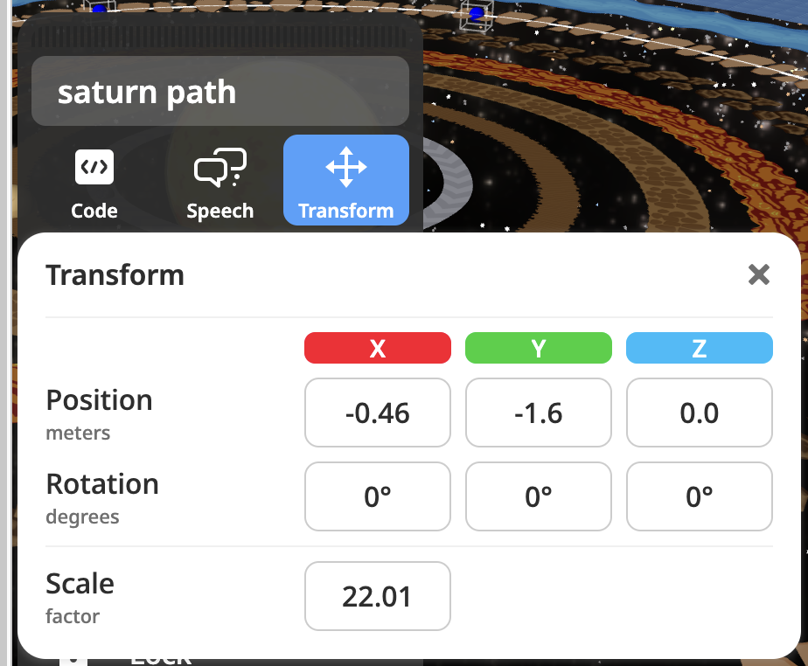

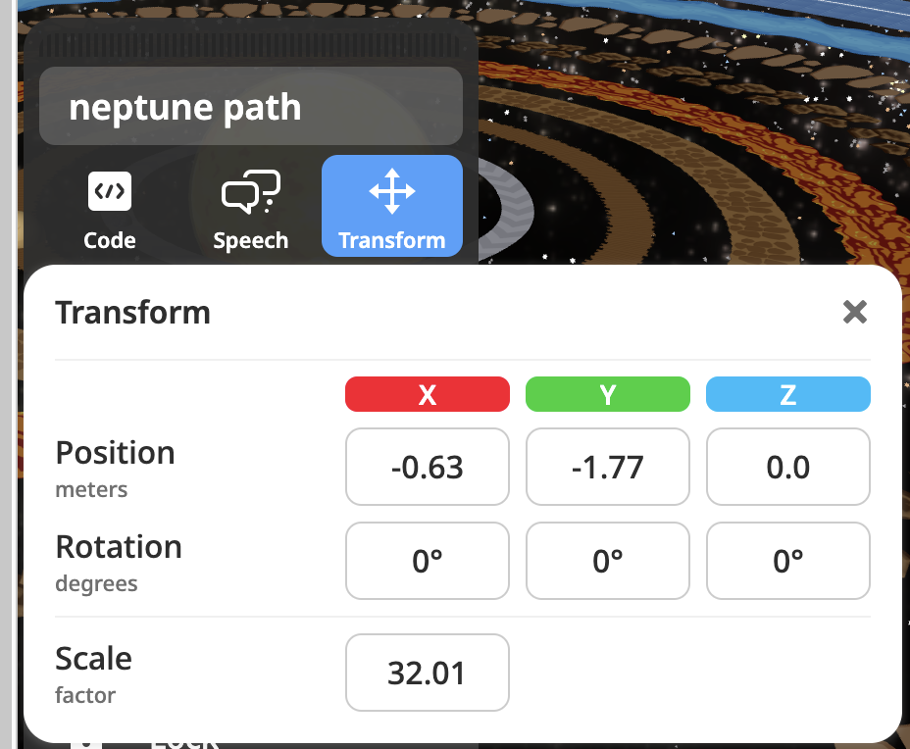

Slide 10
